Slide 1
FITPRO INC – Angular Project
G.Vijay Kumar
19001181

Slide 2
About FitPro Inc
FitPro Inc Provides an Online Solution about Dietary plans, Nutritional Values, Fitness Suggestions and Solutions. They want their solution to be A web based solution as well as accessible on Mobile Apps. This Particular Solution We focus only on Web Based Solution A Single page App need to be built with multiple Flows.

Slide 3
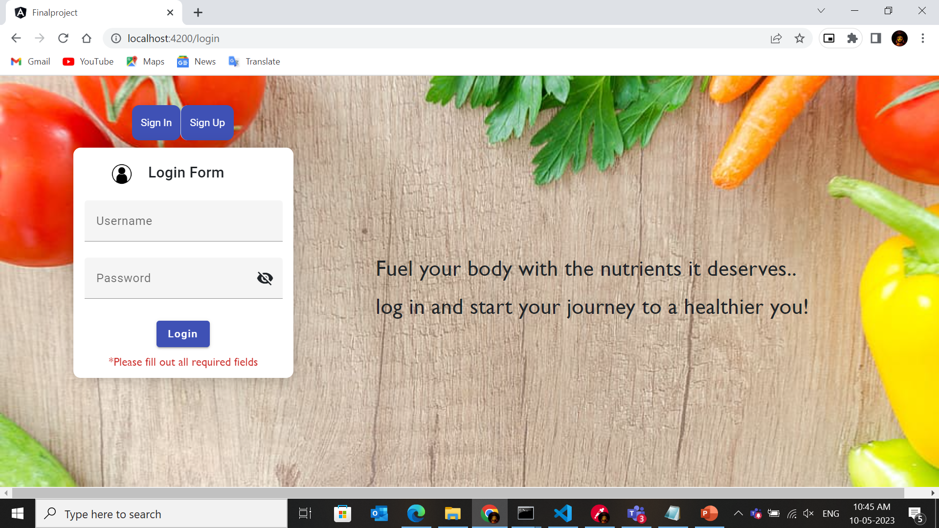
Login Page
Functionalities
SignIn
SignUp
Login button
Techniques used
Model based approach
Validation
Material Module
Toggle Function
Lazy loading
Http Get, post
Note: Image may be blurred. Kindly Zoom In for detailed view

Slide 4
USER SIDE IMPLEMENTATION

Slide 5
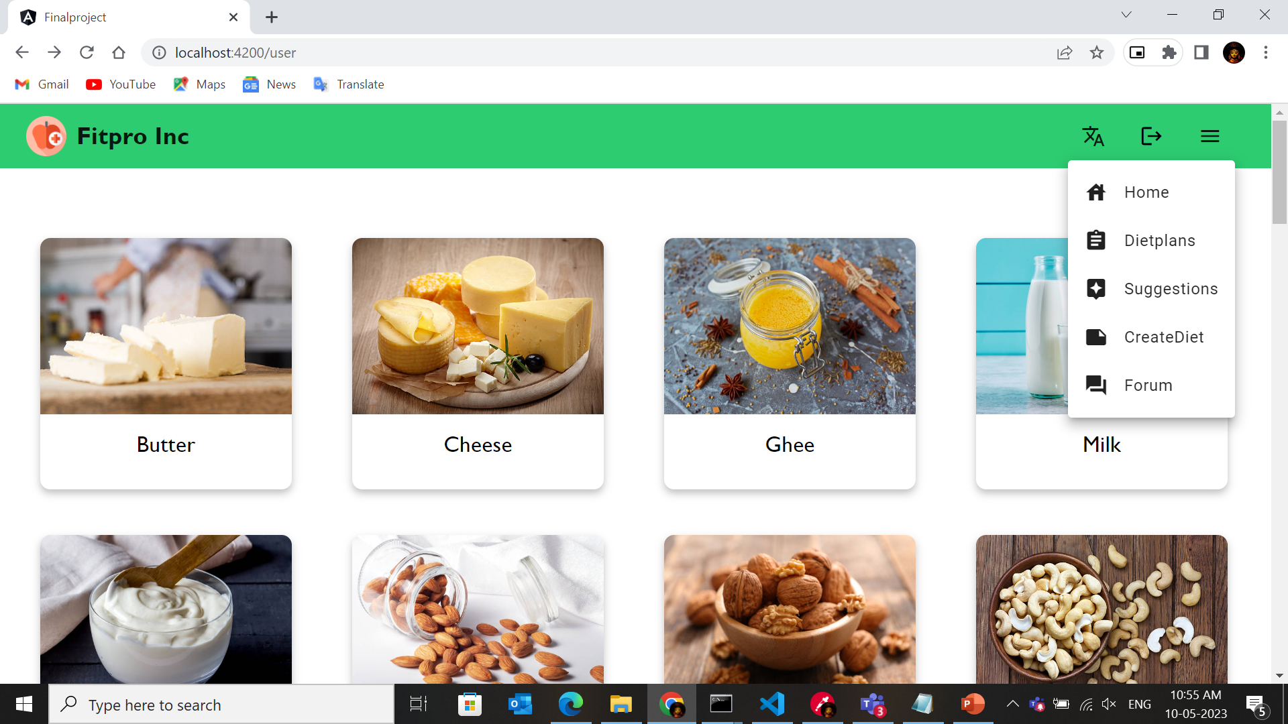
User - Menubar
Functionalities
Language button
Logout button
Menu button
Techniques used
i18N
Material module
Logout Function
Note: Image may be blurred. Kindly Zoom In for detailed view

Slide 6
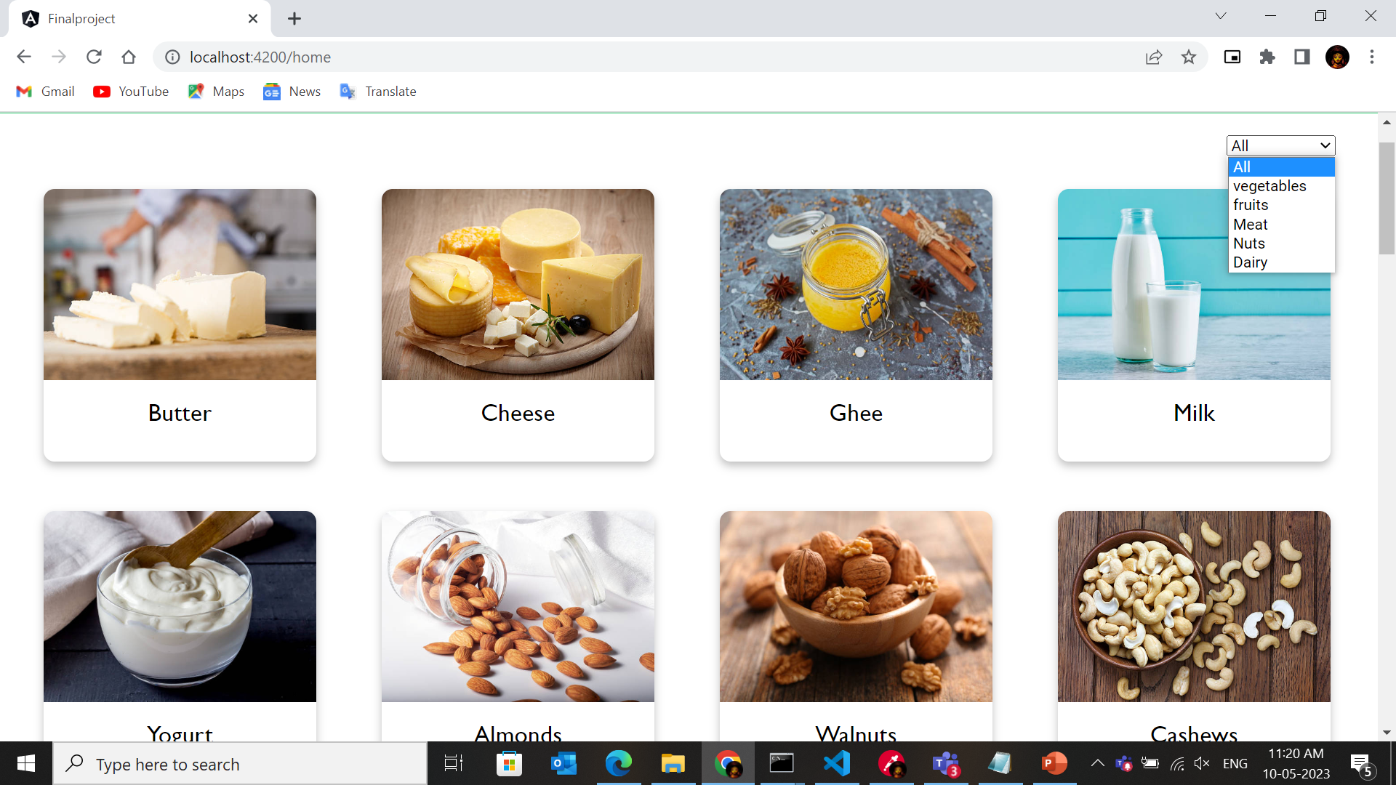
User - Home
Functionalities
Category dropdown
Products
Techniques used
Filter pipe
Material module
Styling card
Http Get method
Note: Image may be blurred. Kindly Zoom In for detailed view

Slide 7
User – Home - Description
Functionalities
Product image
Nutrition values
Techniques used
Routing parameters
Table format
Material Module
Http Get method
Note: Image may be blurred. Kindly Zoom In for detailed view

Slide 8
User - Diet plans
Functionalities
Diet plans
Mat card design
Directives
Techniques used
Material module
Http get method
Note: Image may be blurred. Kindly Zoom In for detailed view

Slide 9
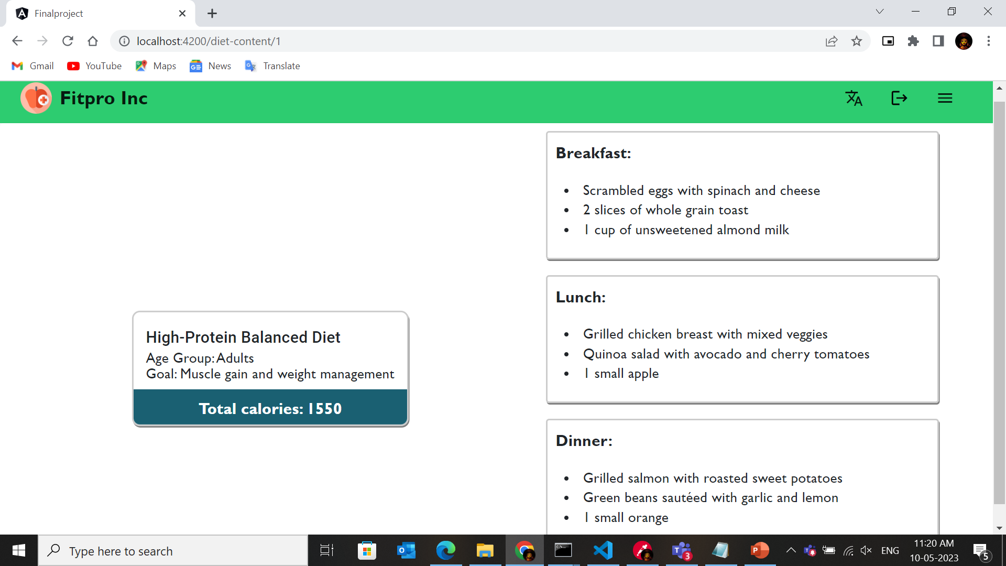
User - Diet plans - Description
Functionalities
Menu Food items
Brief description
Directives
Techniques used
Material module
Http get method
Routing parameters
Note: Image may be blurred. Kindly Zoom In for detailed view

Slide 10
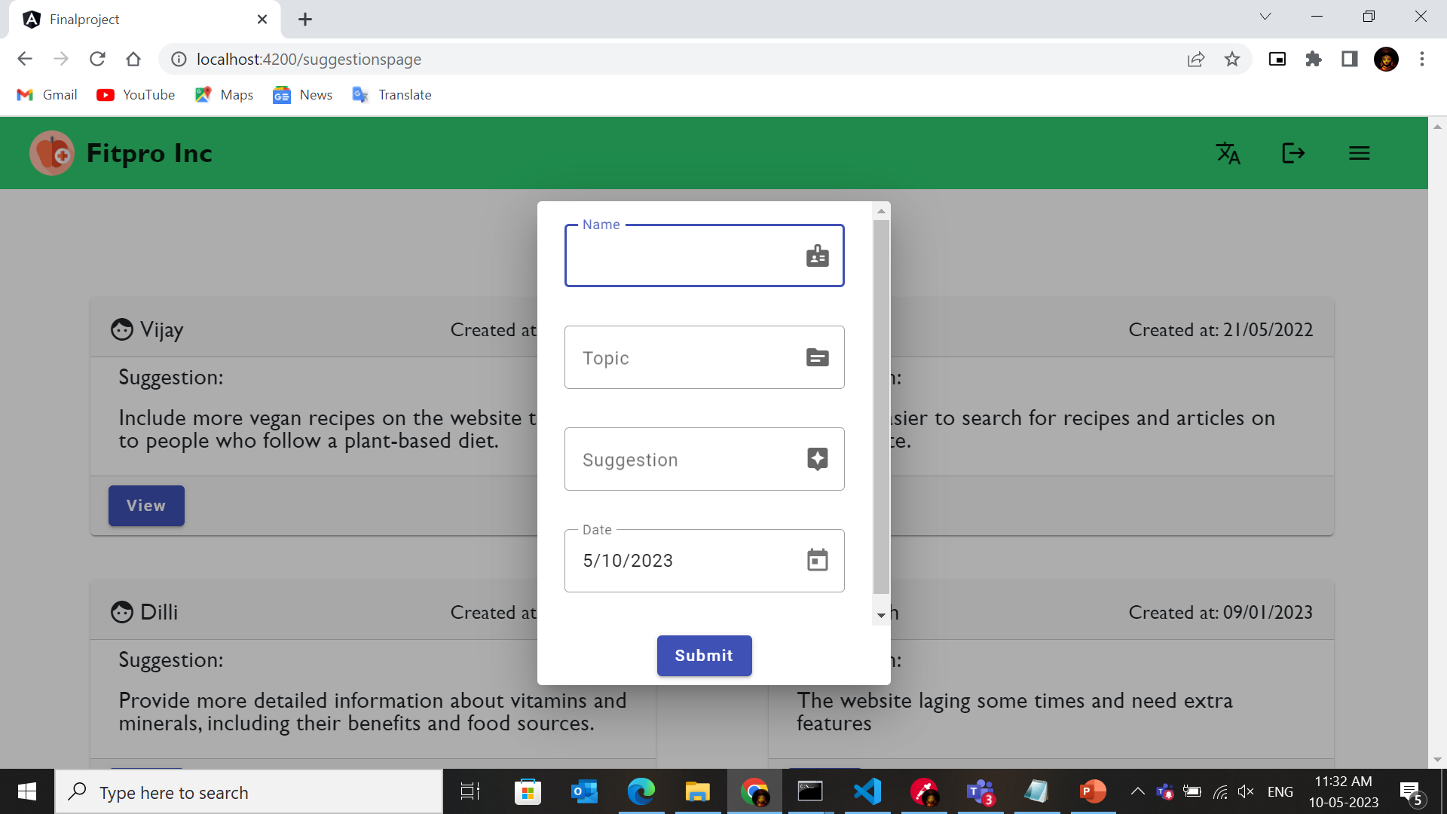
User - Suggestions
Functionalities
Submit button
Date of submit function
Location reload
Form implement
Directives
Techniques used
Material module
Http get, post
Template based Approach
Validation
Note: Image may be blurred. Kindly Zoom In for detailed view

Slide 11
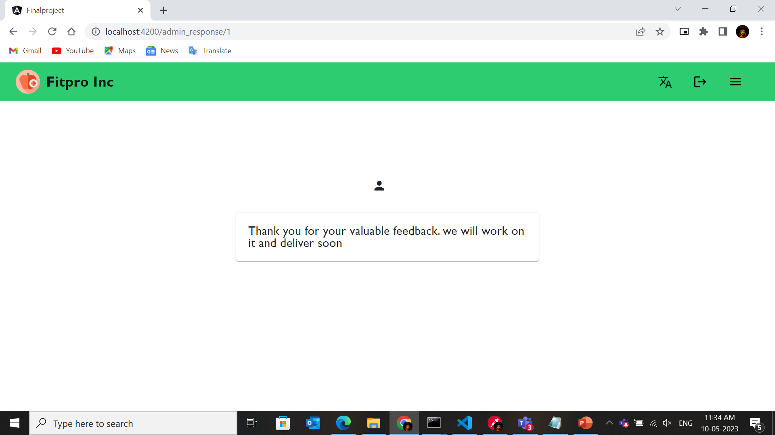
User – Suggestions – Admin view
Functionalities
Admin icon
Mat card design
Data access
Techniques used
Material module
Http get method
Note: Image may be blurred. Kindly Zoom In for detailed view

Slide 12
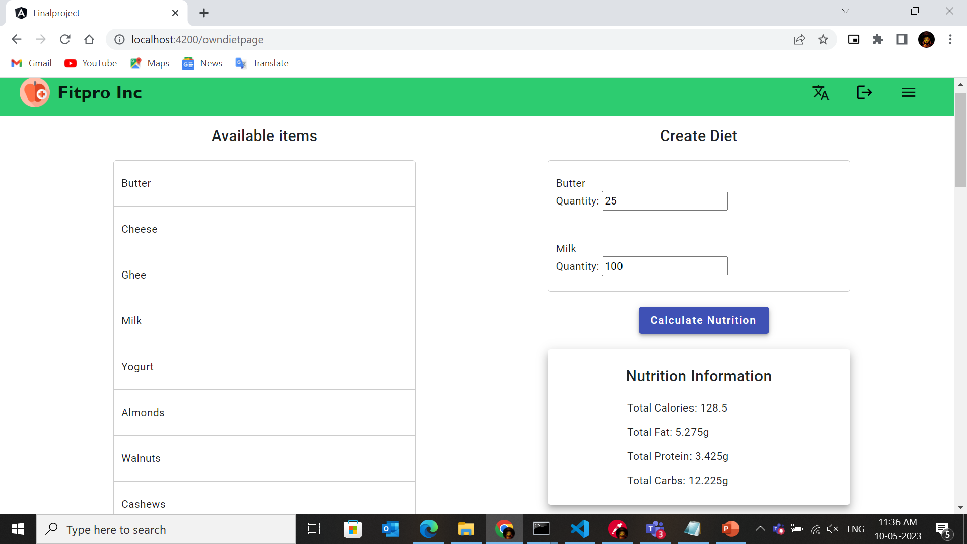
User – Create Diet
Functionalities
Calculate Func
Drag and drop
Mat card
Two way binding
Techniques used
Material module
Http get method
Ip/op directive
Interpolation
Note: Image may be blurred. Kindly Zoom In for detailed view

Slide 13
User – Forum
Functionalities
Limit Function
Input Type
Location reload
Mat card
Techniques used
Material module
Http get, post
Directives
Interpolation
Note: Image may be blurred. Kindly Zoom In for detailed view

Slide 14
User – Forum - responses
Functionalities
Limit Function
User Response
&
Add Response
Location reload
Techniques used
Material module
Http get, put
Directives
Note: Image may be blurred. Kindly Zoom In for detailed view

Slide 15
ADMIN SIDE IMPLEMENTATION

Slide 16
Admin – Adminpage
Functionalities
Image design
Responses button
Products button
Logout button
Mat card
Techniques used
Material module
Logout Functionality
Note: Image may be blurred. Kindly Zoom In for detailed view

Slide 17
Admin – Adminpage - Products
Functionalities
Image design
Search Function
Add product
Mat card
Techniques used
Material module
Search pipe
Http get method
Note: Image may be blurred. Kindly Zoom In for detailed view

Slide 18
Admin – Adminpage – Products - Add
Functionalities
Form based approach
Add product
Mat card
Techniques used
Material module
Template based approach
Http post method
Note: Image may be blurred. Kindly Zoom In for detailed view

Slide 19
Admin – Adminpage - Responses
Functionalities
Menu functionality
Date of creation
Add response
Mat card
Techniques used
Material module
Search pipe
Http get method
Note: Image may be blurred. Kindly Zoom In for detailed view

Slide 20
Admin – Adminpage – Responses - Add
Functionalities
Submit button
Add response
Mat card
Text Limit
Techniques used
Material module
Routing parameters
Http post method
Note: Image may be blurred. Kindly Zoom In for detailed view

Slide 21
Concepts
Implemented
Not - Implemented
Used Component Hierarchy
Used services
Used Pipes
For UI components, used Angular material
Data maintained in Json-server API
Used Routing Parameters
Implemented Lazy loading
Used both Template based & Model based approach
Implemented Multiple user flow
Effective handling of multiple modules
Internationalization
Complex Feature implementation
Security Implementation
Custom Directives

Slide 22
Thank you

